Slide 1
Matrix Properties Algorithms - Python/Scheme
Vital Marciano
Neta Amzalag

Slide 2
Walk through
Algorithm- Gaussian Elimination
Python
Advantages and Disadvantages
Optimization Techniques
Scheme
Advantages and Disadvantages
Optimization Techniques
Results

Slide 3
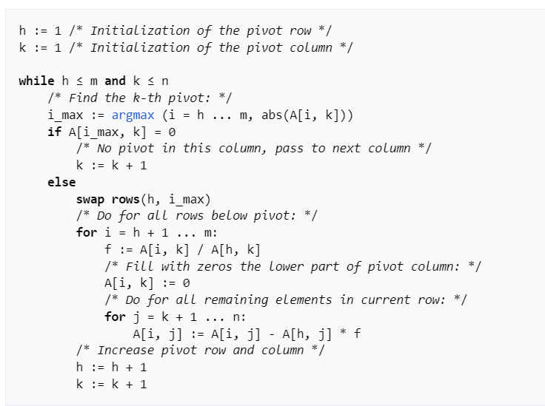
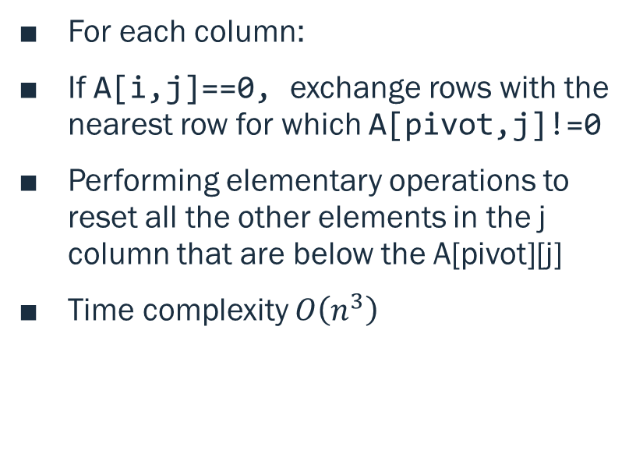
Algorithm -Gaussian Elimination:
For each column:
If A[i,j]==0, exchange rows with the nearest row for which A[pivot,j]!=0
Performing elementary operations to reset all the other elements in the j column that are below the A[pivot][j]
Time complexity $O\left(n^{3}\right)$

Slide 4

Algorithm -Gaussian Elimination:
Gaussian elimination calculation of the matrix (upper triangular matrix)
The determinant is the product of the diagonal elements
Rank Calculation :
Gaussian elimination calculation of the matrix (upper triangular matrix)
Counting the number of non-zero rows.
Inverse Matrix Calculation:
Use Gaussian elimination operations to transform the Input matrix into the identity matrix.
Determinant Calculation :
Apply the Gaussian elimination operations on to an identity matrix to the input inverse matrix.

Slide 5
Python- Advantages and Disadvantage
Advantages:
Disadvantage:
Ease of Use
Python is generally considered easier to learn and use compared to Scheme.
This can be beneficial for rapid prototyping and collaboration with developers who might not be familiar with Scheme.
NumPy's arrays are more compact than Python lists
performance for numerical computations like matrix operations.
Readability
Python code maintains good readability with clear function definitions and comments
Performance Overhead
Compared to compiled languages like C++, Python might have some overhead due to the interpreter layer.
Memory Consumption

Slide 6
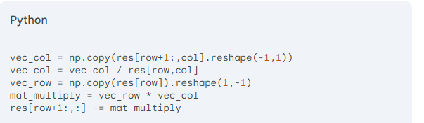
Python- Optimization Techniques
Add the pivot row to the row instead of swap rows
Vectorized Operations:
Instead of iterating through individual elements using loops, NumPy allows calculations on entire arrays simultaneously. This significantly improves performance for matrix operations like row elimination and multiplication.

Slide 7
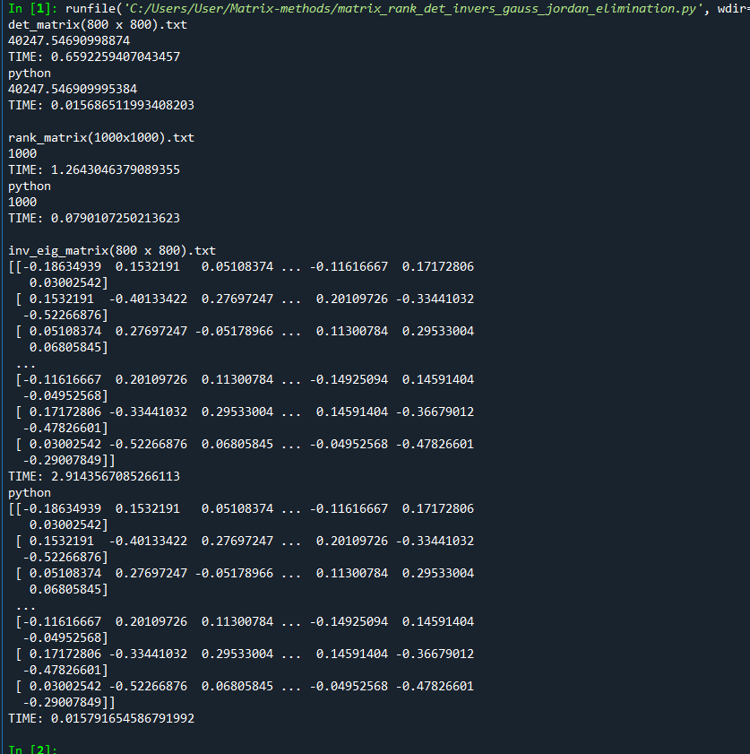
Comparison with existing Python methods

Slide 8
Comparison with existing Python methods

Slide 9
Scheme- Advantages and Disadvantage
Advantages:
Disadvantage:
Tail Call recursion Optimization
Functional Paradigm:
Scheme's functional programming paradigm can lead to concise and expressive code, especially for mathematical computations like matrix operations.
Conciseness:
Scheme is known for its concise syntax, which can lead to shorter and more readable code compared to verbose languages like C++. .
Flomat Usage
Utilizing Flomat helps mitigate the performance concerns to some extent, as it likely provides optimized functions for core matrix operations.
Readability:
The code maintains good readability with clear function definitions and comments.
Performance:
Scheme, especially compared to compiled languages, can be slower for computationally intensive tasks like matrix operations.
This is particularly true for large matrices as seen in our execution times.
Limited Libraries
: While libraries like Flomat exist, the ecosystem of optimized numerical libraries might be smaller compared to languages like Python or C++.
This can limit performance gains, especially for complex linear algebra operations.
Dynamic Typing:
Scheme's dynamic typing can sometimes lead to runtime errors if data types aren't handled carefully.
This can be mitigated with good coding practices and type annotations (available in some Scheme implementations).

Slide 10
Scheme- Optimization Techniques
Add the pivot_row to the row instead of swap rows
Using matrix operations (+, * and more) instead of loops to reset the col elements.
The code utilizes the Flomat library
provides optimized functions for matrix operations like addition, subtraction, and multiplication. This can significantly improve performance compared to implementing these operations from scratch.
Recursive approach for inverse calculation:
The inverse-matrix-calculation function uses a recursive approach to efficiently calculate the matrix inverse.
This can be more memory-efficient compared to iterative approaches.

Slide 11
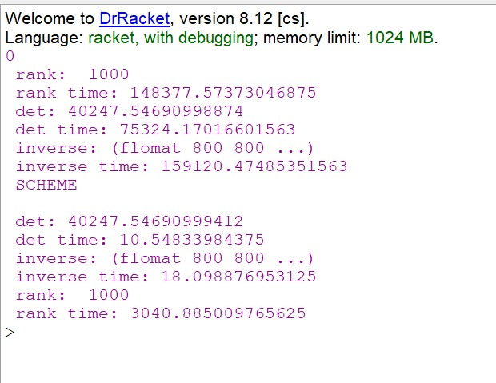
Comparison with existing Scheme- methods

Slide 12
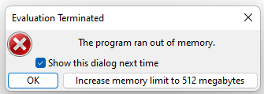
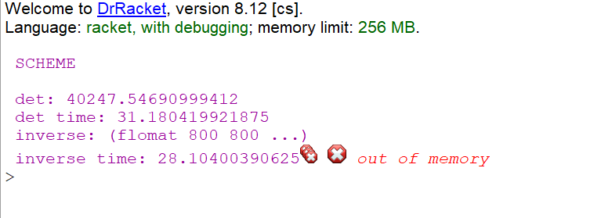
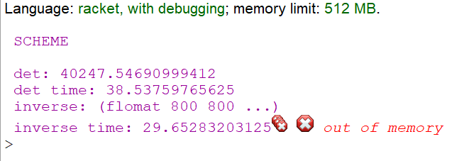
Difference in timing
The Scheme functions uses a lot of memory allocations. In order to calculate these operations using flomat lib methods we needed 1024 MB memory.
Our code can be manage to calculate only with 256MB memory only but with more recursion calls that may effect the times.

